Slide 1
Prevalence/ incidence and burden of pyoderma gangrenosum (PG) and hidradenitis suppurativa (HS)
For PEC endorsement
Yijun Zhou
TA INFL
23-Apr.-2024

Slide 2
ECR Summary
Study Name:
Prevalence/ incidence and burden of pyoderma gangrenosum (PG) and hidradenitis suppurativa (HS)
Study PI:
Prof. Wen-Hui Wang, Peking University Third Hospital &
Prof. Sheng-Feng Wang, Peking University
Study Objective:
1)Prevalence/Incidence rates of PG/HS (including Draining Tunnel).
2)Demographic characteristics, comorbidity ,management and treatment pattern, disease burden including hospitalization, medical expense in patients with PG/HS(include Draining Tunnel).
Database:
Database of Beijing Municipal Health Commission(北京卫健委数据库)
Notes:
欧元汇率：7.6
Leveraging the teaching and research collaboration with Peking University (PKU)

Slide 3
Local data gaps in NS/HS/PG
Data Gaps in China:
Prevalence and incidence: China specific data of prevalence and incidence of NS/HS/PG, HS with draining tunnels, et al.
Natural history and burden of disease: Natural history, clinical burden, comorbidities of NS/PG/HS (HS with draining tunnels, et al.) ,et al. in China.
Disease management: Hospitalisations, Treatment pattern, et al.
HCRU: costs of NS/PG/HS
HCRU: Healthcare Resource utilization
Notes:
2008-2017

Slide 4
Introduction of Database
Data will be obtained from Beijing Municipal Health Commission(北京卫健委数据库)
It covers in-patient and out-patient data of 30 tertiary hospitals from 2017, as well as cover page of in-patient medical records of 300+ hospitals in Beijing from 2008
Total outpatient/ER visits and inpatient numbers for dermatology departments across all hospitals in Beijing
Notes:
2008-2017

Slide 5
Introduction of Database
Data type | Available time | Covered hospital
Out-hospital/ER data (门/急诊病例数据) | 2017-now | 30 hospital in Beijing
Electronic medical records of In-hospital patients (住院电子病历数据) | 2017-now | 30 hospitals in Beijing
Front sheet of in-hospital medical records(住院病案首页数据) | 2008-now | Covered all the hospitals in Beijing(nearly 300 hospitals)
Notes:
2008-2017

Slide 6
Study feasibility
Disease | Number of outpatient and emergency cases | Number of hospitalized cases | Total
PG | 1689 | 723 | 2412
HS | 6963 | 852 | 7815
Netherton Syndrome* | 1 | 0 | 1
*In the inpatient data, there are no diagnoses containing the name "Netherton." However, for outpatient and emergency department patients, since annotations can be added to the coding, three instances of diagnoses mentioning "Netherton" were identified in the data from 2017 onwards. All these records were uploaded by Beijing Children's Hospital affiliated with Capital Medical University and pertain to the same individual.
Feasibility check results support key outcome: the prevalence and incidence rate of HS and PG, but not NS

Slide 7
Study feasibility
1. Data Scope
Covers outpatient, emergency, and inpatient case information, sourced from outpatient and emergency data of 30 hospitals in Beijing, as well as inpatient data from across the city.
2. Data Structure
Patient Information: Gender, date of birth, ethnicity, etc.
Visit and Diagnosis Information: Visit date, outpatient and emergency diagnoses, admission and discharge diagnoses, etc.
Medical Orders Information: Order items, medication dosage, frequency of use, etc.
Cost Information: Total costs, etc.
3. Data Understandability
Documentation and Guides: Includes a data dictionary explaining the data structure and meaning.
Data Standards and Coding: Adopts international standards such as ICD-10.
4. Standardized Data Interface
Provides standardized data conversion formats and interfaces, facilitating data export and integration.
5. Database Technical Support
Provided by the professional technical team of the Beijing Municipal Health Commission Data Center.

Slide 8
For PEC endorsement:
1. NOT to add NS in this study
Based on the database feasibility results—Only 1 NS patient was identified.
One case from this database is not sufficient to generate a robust estimation of incidence/prevalence
NS is an ultra-rare disease that may be underdiagnosed in clinical practice, and 1 NS patient as the numerator may lead to large bias
    - The current database does not cover all hospitals in Beijing, cases from other hospitals may be missed
    - The patients may not be from Beijing, so the denominator of incidence/prevalence cannot be determined
Next step: New study using other potential database will be explored
NOT to add NS in this study
Notes:
HS 窦道 需要花费的时间和金钱成本？

Slide 9
For PEC endorsement:
1. NOT to add NS in this study
Although prevalence and incidence rate of NS will not be calculated, given the rarity of NS, and local data gaps, add a descriptive conclusions to describe the results of NS results in this database is proposed.
As a result, two scenarios were proposed
 | Cons | Pros
(1) add NS in this study | May have extra budget/time cost, (considering the case number, the extra cost is limited.) High risk that no prevalence/incidence rate can be calculated. This is not a efficient way to enrich rare disease patients to describe its characteristics, these data could rely on the chart review study. | the descriptive data can be produced for NS case: disease characteristics, comorbidity, management etc., (this information can also be covered by ongoing NIS study(1368-0121) ) a more broader searching strategy can be used to re-access the NS patients number in this database after study set-up(add more keywords：竹节样发，套叠性脆发，SPINK5，LEKTI, et al.), to find out if there is any potential unidentified NS patients which can support to further generate the EPI rate.
(2)do not include NS in this study (team’s proposal) | Since NS prevalence and incidence rate is local NS data gap to support NS indication application and future rare disease designation, New study using other potential database need to be explored, and there is risk that the results may not timely enough to support. Additional cost for new study is needed. | No extra budget/time cost in this study
Notes:
HS 窦道 需要花费的时间和金钱成本？

Slide 10
For PEC endorsement:
1. NOT to add NS in this study
1.使用Netherton进行检索，结果仅包含1例患者
2.扩大检索范围：
目标：综合使用ICD编码和文本搜索识别可能的Netherton综合征患者。
步骤：
● 鱼鳞病和特应性皮炎的检索：使用相关的ICD-10代码——后天性鱼鳞癣（L85.001）寻常型鱼鳞病（Q80.001）性联鱼鳞病（Q80.101）板层状鱼鳞病（Q80.201）大疱型红皮病型鱼鳞病（Q80.301）非大疱型红皮病型鱼鳞病（Q80.801）先天性鱼鳞病（Q80.902）特应性皮炎（L20.901）特应性皮炎（轻度）（L20.902）特应性皮炎（中重度）（L20.903）——进行初步检索。
● 文本搜索：“竹节发”作为关键词进行文本搜索，筛选出提及该描述的病例。
● 组合搜索：对于已经根据ICD编码识别的病例，进一步检查它们是否也有提及“竹节发”的文本描述。这可能涉及手动审核电子病历。
● 综合分析：将同时满足鱼鳞病或特应性皮炎诊断代码，且文本中有“竹节发”描述的病例，视为可能的Netherton综合征患者。
综合建议
在识别出特定疾病的某一条患者记录后，进一步提取该患者的所有就诊记录，包括门诊和住院信息。之后，对这些信息进行合并和分析，以剔除重复数据。这种方法不仅有助于提高数据质量，还能确保检索出的疾病记录更为准确和全面。
Netherton这个病是没有ICD-10编码的，只能通过诊断名称检索Netherton。根据上述检索策略，得到的综合结果仅有1例。
Notes:
HS 窦道 需要花费的时间和金钱成本？

Slide 11
For PEC endorsement:
2. add HS with Draining Tunnel(DT) in Key Outcome analysis
(1)DT is important in HS clinical development:
As a key inclusion criteria in HS lunsayilTM trial (.98)
Primary endpoint of HS lunsayilTM trial (.98) is the percent change from baseline in DT
The prevalence/ incidence rate, natural history and burden of disease, treatment pattern, et al of HS with DT are China local data gaps which need to be filled.
(2) Statistical Analysis strategy in DT：
Natural language Processing (NLP) will be used to identify HS patients with DT
After the feasibility check, In-hospital data with electronic medical records (住院电子病历数据) in 30 hospitals as new additional data sources in this database will support the identification of DT.

Slide 12
For PEC endorsement:
2. add HS with Draining Tunnel in Key Outcome analysis
If add HS with Draining Tunnel
Budget impact：add 200,000 CNY
Timeline impact: add 3 months extra time for data analysis
Statistical Analysis ：use In-hospital data with electronic medical records (住院电子病历数据) in 30 hospitals

Slide 13
For PEC endorsement:
3. Timeline updates for PEC endorsement
2023 |  | 2024 |  |  |  |  |  |  |  |  |  |  |  | 2025 |  |  |  |  |  |  |  |  |  |  |  | 2026 |  |  |  |  |  |  |  |  |  |  |  | 2027
11 | 12 | 1 | 2 | 3 | 4 | 5 | 6 | 7 | 8 | 9 | 10 | 11 | 12 | 1 | 2 | 3 | 4 | 5 | 6 | 7 | 8 | 9 | 10 | 11 | 12 | 1 | 2 | 3 | 4 | 5 | 6 | 7 | 8 | 9 | 10 | 11 | 12 | 1 | 2 | 3 | 4 | 5 | 6 | 7 | 8 | 9
PI submit
ECR application
2rd PEC
endorse
Global
endorse
Contract
Sign-off
Manuscript submission of PG
PEC
endorse
Feasibility assessment
Protocol preparation
Protocol approval
EC
Approval
Data collection period of PG
Data analysis
of PG
Study report draft of PG
Manuscript submission HS
Data collection period of HS
Data analysis of HS
Study report draft of HS
Extra time for Draining Tunnel
Extra time for Draining Tunnel
PG
CN sNDA sub
Apr 2027
CN sNDA sub
Apr 2028
HS
Notes:
时间表重新修改

Slide 14
For PEC endorsement:
4. budget update
After the feasibility, the complication of different data source and database process compared with the previous IIS study in GPP , PI proposed a new budget assumption.
The main changes in: 1. add DT in outcome analysis ; 2.extra time and workload in data cleaning and analysis; 3. hospital/ department management fee(15%+5%)
Item | Details
Study Type | Epidemiologic study
Study Data Source | Database of Beijing Municipal Health Commission(北京卫健委数据库)
No. of Subjects | Feasibility results
Study budget assumption (local budget) (previous version: 1,000,000 CNY) | Total budget (with DT): 1,900,000 CNY

Slide 15
4. budget details
预算内容 | 工作内容 | PG测算依据 | PG | HS测算依据 | HS | 合计
设计、修订和制定方案、统计流行病学分析计划(SEAP)和研究准备 | 发病率估计 | 15小时 | 40,000 | 10小时 | 28,000 | 68,000
 | 患病率估计 | 15小时 |  | 10小时
 | 治疗负担测算 | 10小时 |  | 5小时
 | 合并症统计 | 10小时 |  | 10小时
统计分析编程 | 发病率估计 | 15小时/人×2人 | 96,000 | 20小时/人×2人 | 112,000 | 208,000
 | 患病率估计 | 15小时/人×2人 |  | 20小时/人×2人
 | 治疗负担测算 | 10小时/人×2人 |  | 10小时/人×2人
 | 合并症统计 | 20小时/人×2人 |  | 20小时/人×2人
研究报告撰写 |  | 60小时/人×2人=216,000元 | 96,000 | 70小时/人×2人 | 112,000 | 208,000
IRB伦理审查费 |  | 函审及上会伦理审查费用 20000 |  |  | 10000 | 20,000
专家咨询费 |  | 1500元/人次×16人次 | 24,000 | 1500元/人次×16人次 | 24,000 | 48,000
差旅费 |  | 单次差旅费 3,520，4人次 | 14,080 | 单次差旅费 3,520，4人次 | 14,080 | 28,160
国际合作与交流费 |  | 用于参加国际会议，每人次2万，预计参加2人 | 40,000 | 用于参加国际会议，每人次2万，预计参加2人 | 40,000 | 80,000
会议费 |  | 用于项目研究过程中组织开展学术研讨、咨询发生的会议费用，计划召开项目启动会（1次），会期1天，参加人员10人。按照平均550元/人次标准（含住宿、餐饮、会议室租赁费、会议材料印刷费、交通费等），共计550元/人天/次×1天×10人 | 5,500 | 用于项目研究过程中组织开展学术研讨、咨询发生的会议费用，计划召开项目启动会（1次），会期1天，参加人员10人。按照平均550元/人次标准（含住宿、餐饮、会议室租赁费、会议材料印刷费、交通费等），共计550元/人天/次×1天×10人=5,500元。 | 5,500 | 11,000
交通费 |  | 咨询专家产生的市内交通费 前往数据源分析数据 | 10,000 | 咨询专家产生的市内交通费 前往数据源分析数据 | 12,000 | 22,000
出版文献信息知识产权费 |  | 发表SCI文章：15000元/篇×1篇=15,000元 | 15,000 | 发表SCI文章：15000元/篇×1篇=15,000元 | 15,000 | 30,000
其他费用 |  | 印刷费、邮寄费等 | 17,020 | 印刷费、邮寄费等 | 18,260 | 35,280
测试化验加工费（数据合作方数据处理费用） | 发病率估计 | 分母及分子数据的提取、清洗和标准化，涉及到分层数据的切割。120000元 | 400,000 | 由于窦道研究中疾病的提取无法依赖大部分数据提取工具和ICD编码，需要工程师用基础名称和代码将数据进行切分后人工识别，由此产生额外的分母及分子数据的提取、清洗和标准化，涉及到分层数据的切割费用 100000元 | 300,000 | 700,000
 | 患病率估计 | 分母及分子数据的提取、清洗和标准化，涉及到分层数据的切割。120000元 |  | 由于窦道研究中疾病的提取无法依赖大部分数据提取工具和ICD编码，需要工程师用基础名称和代码将数据进行切分后人工识别，由此产生额外的分母及分子数据的提取、清洗和标准化，涉及到分层数据的切割费用。100000元
 | 治疗负担测算 | 费用数据的提取和清洗及标准化。60000 |  | 费用数据的提取和清洗及标准化。40000
 | 合并症统计 | 疾病名称提取、清洗和标准化。160000 |  | 疾病名称提取、清洗和标准化。60000
医院管理费(15%) |  | - | 150,000 | - | 135,000 | 285,000
科室管理费(5%) |  | - | 50,000 | - | 45,000 | 95,000
VAT增值税费(3.24%) |  | - | 32,400 | - | 29,160 | 61,560
合计 |  | - | 1,000,000 | - | 900,000 | 1900000

Slide 16
Study budget assumption(previous version)
Item | Amount (10,000)
Service fee | 21
Project Management fee | 16
Data analysis fee | 48
Institution administrative fee and tax | 7
Publication fee | 8
SUM | 100

Slide 17
PEC Review Meeting – Request to PEC
Request to PEC:
NOT to add NS in this study
To endorse: add Draining Tunnel in outcome analysis
To endorse: new timeline
To endorse: budget update

Slide 18
THANKS

Slide 19
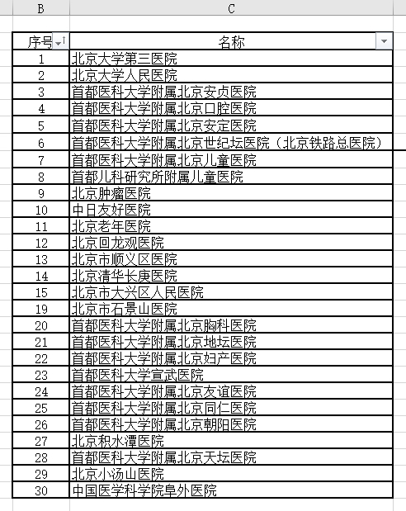
Introduction of Database

Slide 20
Study Design—Study Population
The database is documented with basic demographics, dates of hospital visits, medication use, discharge diagnoses in Chinese and corresponding International Classification of Diseases, 10th Revision (ICD-10) codes.
We will conduct a retrospective study using data from January 1, 2017, to December 31, 2023.
We will exclude residents (1) without a valid unique ID and (2) had conflicting information recorded。
All claim records will be deidentified to protect people’s privacy.

Slide 21
Study Design—Statistical Analysis
The prevalence and incidence in 2023 will be calculated，incorporating specifically defined wash-out periods to ensure the most accurate representation of new cases. All cases will have a 5-year wash-out period set. These wash-out periods, the maximum feasible based on the data available, are intended to minimize the inclusion of prevalent cases from previous years in the 2023 incidence estimates.
The prevalence and incidence will be stratified by gender and age (0-9, 10–11, 12-17, 18-19, 20-29, 30–39, 40–49, 50–59, 60–69, 70–79, and ≥ 80 years).
Numerator Calculation: we begin by aggregating the new outpatient and inpatient case numbers from 30 hospitals. Additionally, we collect data on the new inpatient cases of this disease from all hospitals across Beijing. Using a regression model developed from the ratios of outpatient to inpatient cases in the specific 30 hospitals and their dermatology department's outpatient to inpatient ratios, we estimate the new outpatient cases for the remaining hospitals in the city. The final step involves summing up all estimated outpatient cases with the collected inpatient cases across Beijing to determine the total number of new cases.
Denominator Calculation: The denominator is the population number from the 2020 Seventh National Census of Beijing as reported by the Beijing Municipal Bureau of Statistics.
Notes:
洗脱期：5年：
0-9，10-11，12-17，18-19
2020年人口普查，北京市（分母）
分子：门急诊（30）+全北京住院（全北京）。估算门急诊

Slide 22
Study Design— PG and HS Identification
Identification of PG Cases
ICD-10 Code: L88xx01
Search Strategy: The database query system will be used to input the ICD-10 code L88xx01 as the search criterion. The search will be set to exact match to ensure that only patient records diagnosed with Pyoderma Gangrenosum are retrieved.
Identification of HS Cases
ICD-10 Codes: L73.803 (Triad of Follicular Occlusion), and L66.301 (Abscessing Perifolliculitis of the Scalp)
Diagnosis Names (in Chinese)：Abscessing Perifolliculitis of the Scalp, Perforating Folliculitis, Inverse Acne, Hidradenitis
Search Strategy: The retrieval system will set up the search conditions to link these ICD-10 codes and diagnosis names using the "OR" logical connection. This setup ensures that patient records listed with any of these codes and diagnosis names as the primary or secondary diagnosis are included in the search results.

Slide 23
Study Design— PG and HS Identification
Patient unique coding definition
For the specific disease cases filtered from the database, the patient's unique identifier (identity number; if not available, then by name + date of birth + gender) will be used to extract all of the patient's medical records, including outpatient, emergency, and inpatient records. Outpatient and inpatient records will be merged to create a comprehensive medical history for each patient.
Data Handling
Privacy: All patient information will be handled in compliance with relevant data protection regulations to ensure confidentiality and privacy.

Slide 24
Study Design—Sensitivity analyses
Sensitivity analyses will be conducted to assess the robustness of the results:
(1) including only observed cases to assess the lower bounds of the rates,
(2) including all uncertain PG and HS cases,
(3) estimating incidences with a 5-year wash-out period.
(4) impact of COVID-19 will be taken into consideration

Slide 25
Study Design—Key Outcome
1)Prevalence/Incidence rates of PG/HS (including Draining Tunnel).
2)Demographic characteristics, comorbidity ,management and treatment pattern, disease burden including hospitalization, medical expense in patients with PG/HS(include Draining Tunnel).
Notes:
HS 窦道 需要花费的时间和金钱成本？

Slide 26
Communication/Publication plan
Meeting: National and international conferences
Topics: Prevalence and burden of PG / HS
Manuscript: SCI article
Others: Establish a PG and HS cohort

Slide 27
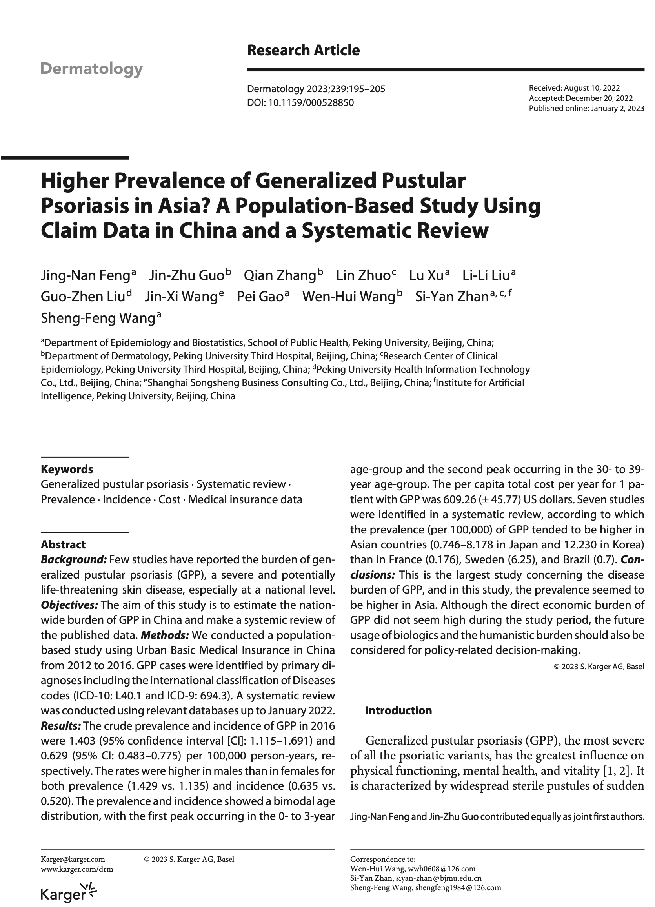
PI information
Wen-Hui Wang
MD, Chief physician, Associate professor
Chair, Department of Dermatology, Peking University Third Hospital
Co-corresponding author of epidemiology and burden of GPP
Sheng-Feng Wang
School of Public Health, Peking University(PKU)
author of epidemiology and burden of GPP

Slide 28
Disease overview—Pyoderma gangrenosum (PG)
A rare neutrophilic dermatosis
Rapidly expanding, suppurative ulcers that heal with cribriform scarring
Pathergy: arise after surgical intervention in the absence of predisposing conditions
Underlying systemic illness: more than half of patients
  Inflammatory bowel disease (IBD)
  Hematologic disorders
  Solid organ malignancy
  Inflammatory arthritis

Slide 29
Reductions in quality of life in PG
Severe pain
Sleep disturbances
Poor appetite
High rates of depression, anxiety and social isolation: chronic wounds with associated drainage
Delays in diagnosis
Multiple disease-exacerbating debridements
Unnecessary antibiotics
Other inappropriate therapies

Slide 30
Prevalence of PG
The age- and sex-standardized prevalence of PG among the study population was 0.0058%, or 5.8 PG cases (95% confidence interval [CI], 5.6-6.1) per 100,000 adults in the United States.
Adjusted prevalence was nearly twice as high among women (7.1 cases [95% CI, 6.7-7.5] per 100,000) than men (4.4 cases [95% CI, 4.0-4.7] per 100,000).
Patients between the ages of 70 and 79 years had the highest standardized prevalence (9.8 cases [95% CI, 8.8-10.9] per 100,000), with patients aged ≥50 years representing nearly 70% of all PG cases.
There is no data about prevalence of PG in China

Slide 31
Burden of PG
Overall burden of disease is poorly understood
The prevalence of hospitalization for PG increased between 2002 and 2012 in the United States.
 |  | Adults | Children
Per million hospitalized (N) |  | 31 to 39 | 2 to 11
Cost per year with a primary diagnosis of PG |  | $9,766,542 | $2,202,576
Geometric-mean [95% CI] cost of hospitalization | With a primary diagnosis of PG | $8111 [$7728–$8513] | $7,995 [$5,838-$10,950]
 | Without a primary diagnosis of PG | $7622 [$7540–$7704] | $4,481 [$4,296-$4,674]
Geometric-mean [95% CI] length of stay (days) | With a primary diagnosis of PG | 5.7 [5.4–5.9] | 5.0 [3.7–6.8]
 | Without a primary diagnosis of PG | 3.5 [3.5–3.5] | 2.7 [2.7–2.8]
There is no data about disease burden of PG in China

Slide 32
Disease overview—Hidradenitis suppurativa (HS)
An immune-mediated, relapsing, chronic inflammatory dermatosis
Affecting the intertriginous skin of axillary, inguinal, and perianal sites
Deep-seated, inflammatory nodules, painful abscesses and secondary scarring
Subsequent malodorous draining sinus tracts and fistulas
Substantial psychological and emotional burdens
Physical comorbidity

Slide 33
Prevalence of HS
 | Meta Analysis | Meta Analysis
Study size | 16 studies 38,082,054 | 16 studies 118,760,093
Areas | Western European and Scandinavian countries the US Australia | Europe 0.8% (0.5–1.3%) USA 0.2% (0.1–0.4%) Asia-Pacific 0.2% (0.01–2.2%) South America 0.2% (0.01–0.9%)
Overall prevalence | 0.40% | 0.3%
95%CI | 0.26%-0.63% | 0.2–0.6%
There is no data about prevalence of HS in China

Slide 34
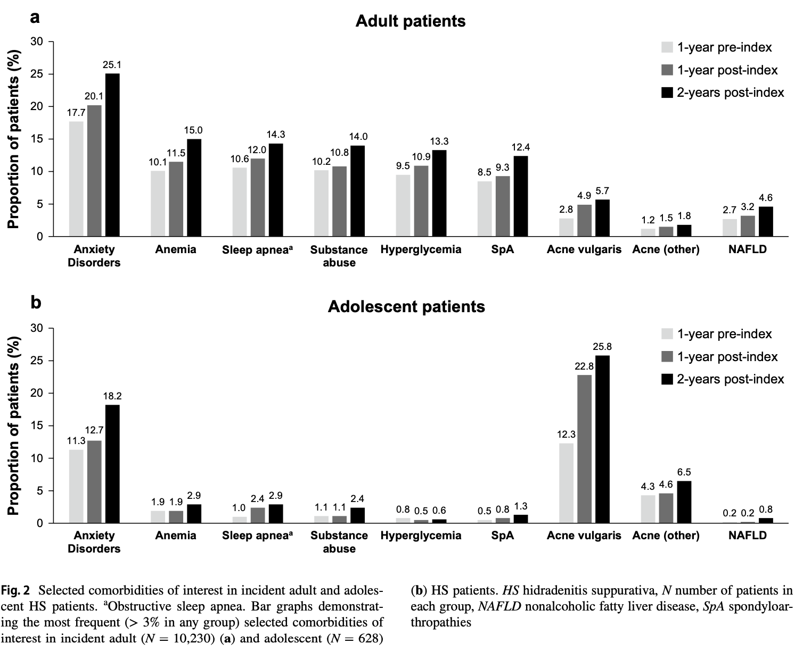
Burden of HS
In adult and adolescent patients with HS, comorbidity burden continues to increase after diagnosis in the United States.
There is no data about disease burden of HS in China
 | Adults (≥ 18 years) | Adolescent (12–17 years)
Total healthcare costs in the 2-years post-index period | $42,143 | $16,057
Outpatient costs | $20,980 | $8408

Slide 35
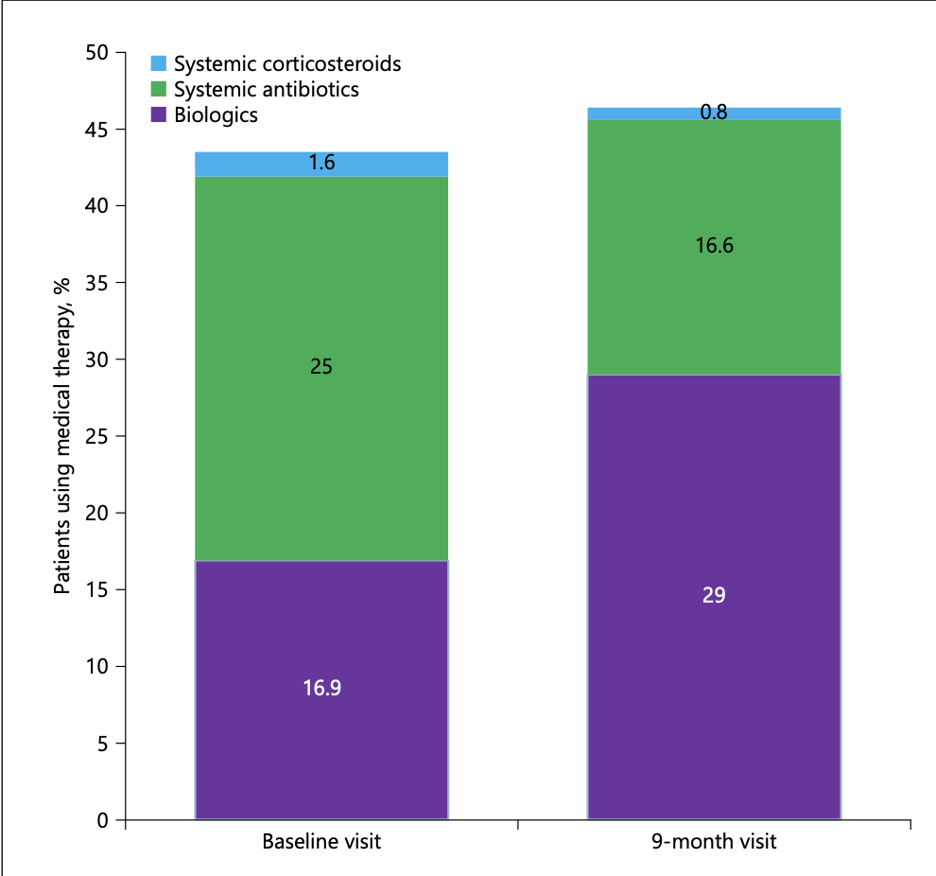
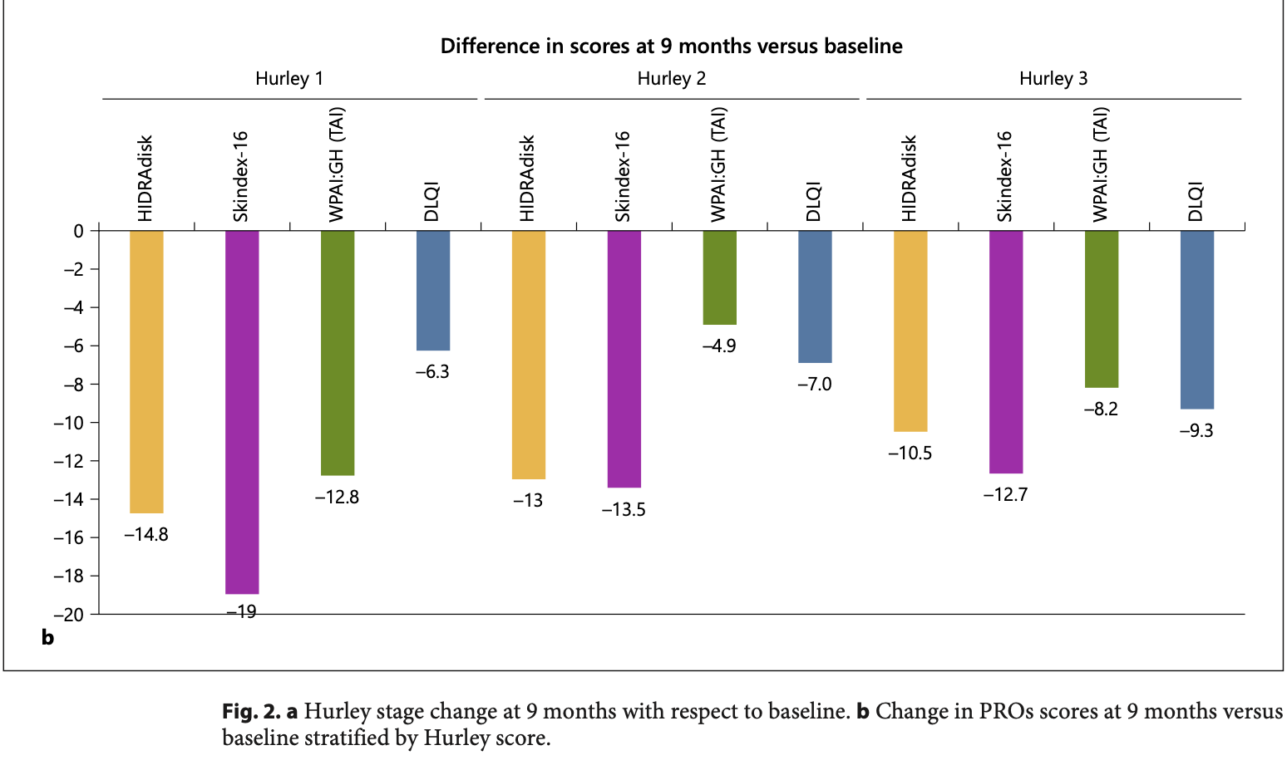
Treatment improved quality of life in HS
At baseline, most patients had a Hurley severity stage of 2 (43.9%), a moderate HS-PGA score (57.1%), and poor QoL (HIDRAdisk: 65.7 ± 23.3, Skindex-16: 60.3 ± 26.9, and DLQI: 10.8 ± 8.1).
Patients with more severe disease showed worse QoL.
Mean values for the variables related to HS severity decreased during the study period.
The achievement of HiSCR and partial response increased during the study.

